Slide 1

Graph Theory and its Applications
Barabasi Albert (BA) Preferential Attachment Model
Dr. Arti Arya
Department of Computer Science
and Engineering

Slide 2

Graph Theory and its Applications
Barabasi Albert (BA) Preferential Attachment Model
Dr. Arti Arya
Department of Computer Science and Engineering

Slide 3
Graph Theory and its Applications Disclaimer
The course slides are prepared by Prof. BhaskarJyoti. But various additional inputs are added by me from various reliable resources from Foreign and Indian Universities as well as from sites.
Notes:
Ok. Having said that, lets get back to what we were speaking about.
Input devices. We have seen that the virtual reality eco system largely encompasses three fundamental components that include
HMD – head mounted devices that give you immersive VR experience, we saw some examples in the last class like the HTC VIVE, Oculus Rift, Samsung gear and so on. Some of you have also used few of these and experienced it for a few minutes.
And the second components is the GTD or the Gesture Tracking Devices. We saw a video of Xsense IMU sensors that can accurately estimation the position and orientation of a dancer. we will in the next hour see how these gesture tracking devices work and what are the various technicalities that go into tracking. I will try to keep it as non-mathematical as possible, as the mathematics behind it can get pretty messy and complicated. However, if you are interested in the mathematical aspects, I will be more than happy to discuss.
On the screen you can see that a 3 directional coordinate system is depicted. The 3 primary axes of a 3d coordinate system is X, Y and Z axis. Hear I would like to know where, when and why in your past have you encountered 3 dimensional coordinate system.
Give some time to the students to ponder on
Ok, if I tell you, I have encountered 2 dimension in images, drawings, sketch and so on. While I have encountered 1 dimension when I want to know the temperature currently or current time or something like that. Similar, where and when have you encountered 3D, either consciously or subconsciously.
Explain the roll pitch and yaw concepts.
Degree of freedom

Slide 4
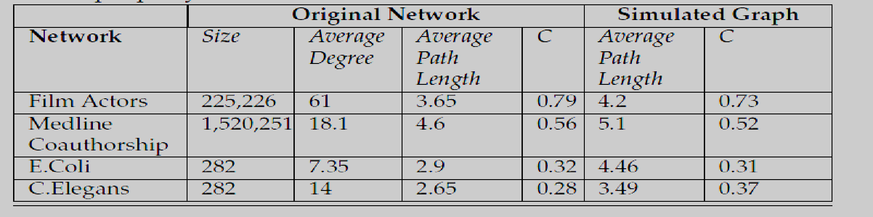
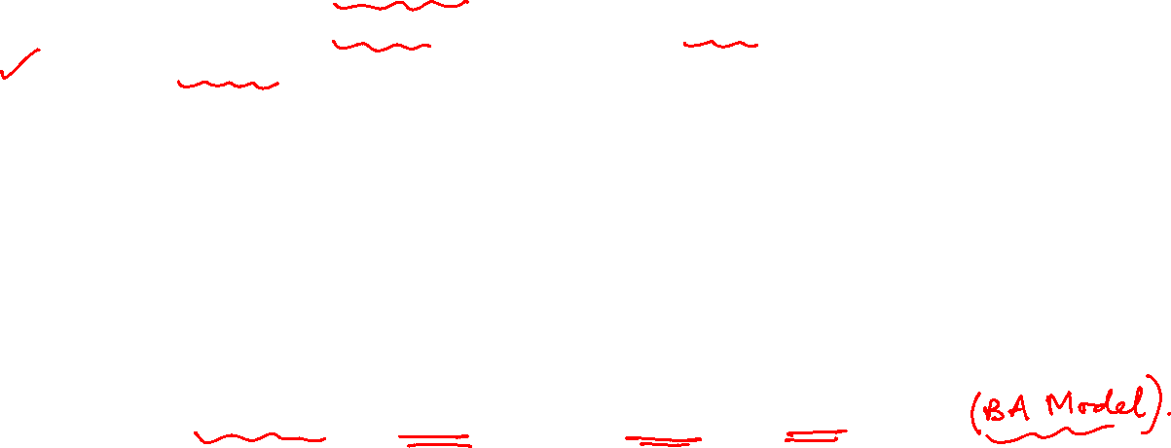
Graph Theory and its Applications
We saw in Small World Model that average path length is small and Clustering Coeff is high but Small World model doesn’t follow Power Law and which is a desirable property of any real world model.
So comes Preferential Attachment or Barabasi Albert Model.
Barabasi Albert ( BA) Preferential Attachment (PA) model

Slide 5
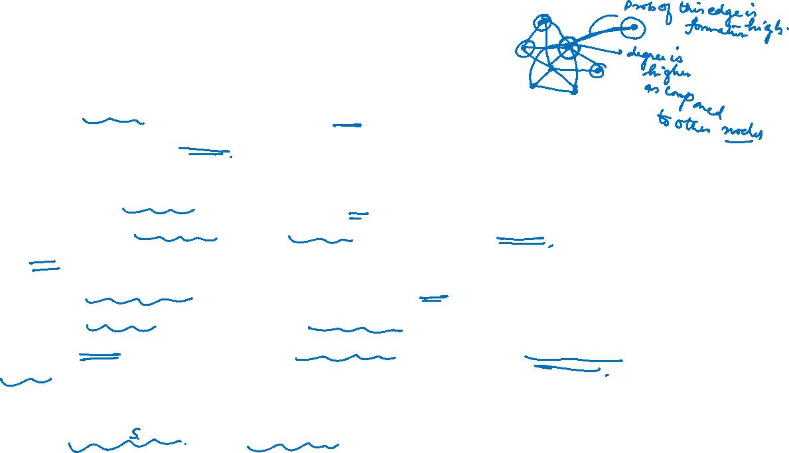
Graph Theory and its Applications
Barabasi Albert ( BA) Preferential Attachment (PA) model
When new nodes are added to networks, they are more likely to connect to existing nodes that many others have connected to.
When a new user joins the network, the probability of connecting to existing nodes is proportional to the nodes’ degree
Unlike random graphs in which we assume friendships are formed randomly, in the preferential attachment model we assume that individuals are more likely to befriend gregarious others.
Examples
The rich get richer, aristocrat network

Slide 6
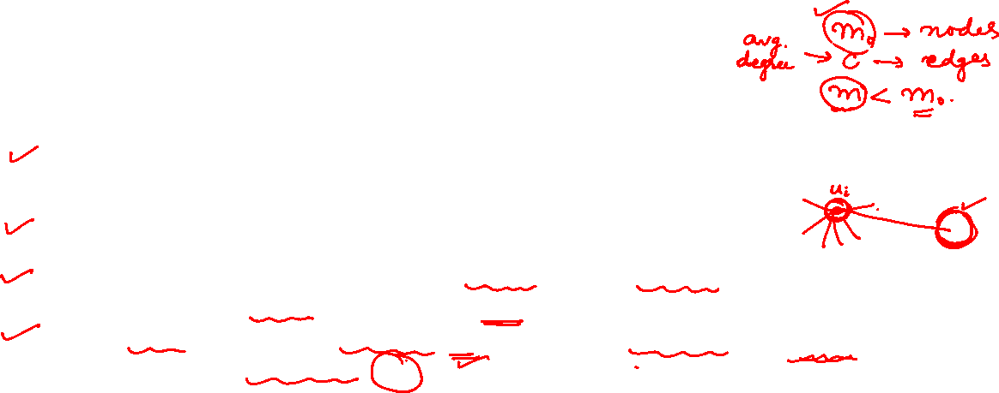
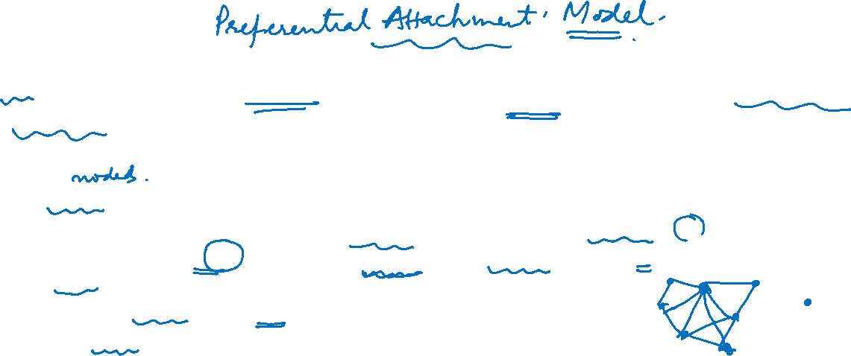

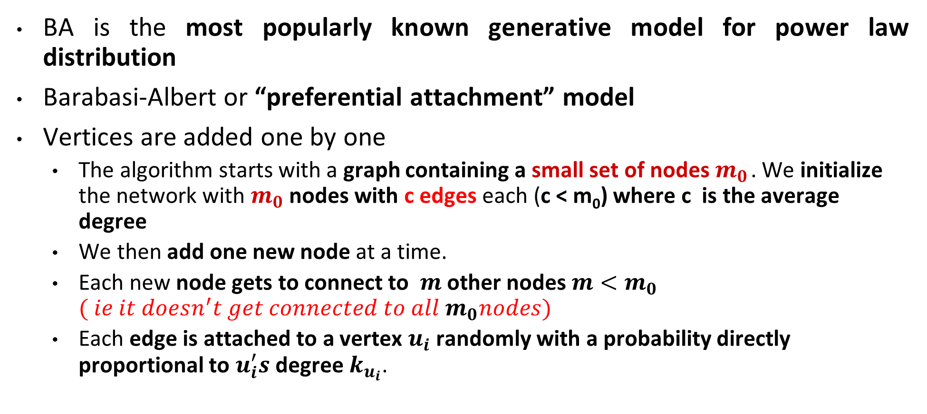
Graph Theory and its Applications
Basic assumption
BA is the most popularly known generative model for power law distribution
Barabasi-Albert or “preferential attachment” model
Vertices are added one by one
The algorithm starts with a graph containing a small set of nodes $m_{0}$ . We initialize the network with $m_{0}$ nodes with c edges each (c < m₀) where c is the average degree
We then add one new node at a time.
Each new node gets to connect to $m$ other nodes ${m<m}_{0}$ $( ie it doesn^{′}t get connected to all m_{0}nodes)$
Each edge is attached to a vertex $u_{i}$randomly with a probability directly proportional to $u_{i}^{′}s$ degree $k_{u_{i}}$.

Slide 7
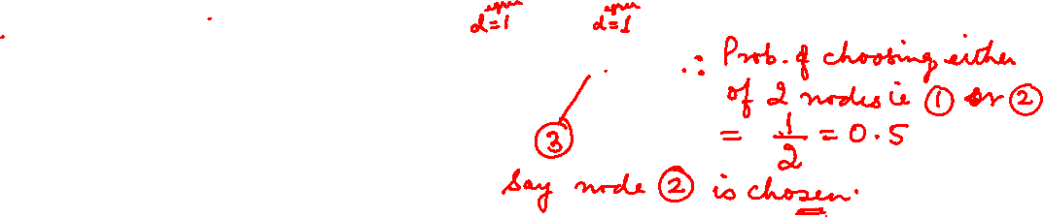
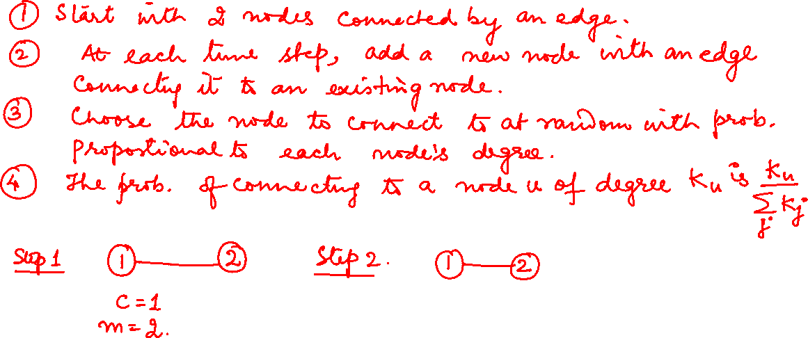
Graph Theory and its Applications
Preferential Attachment Model

Slide 8
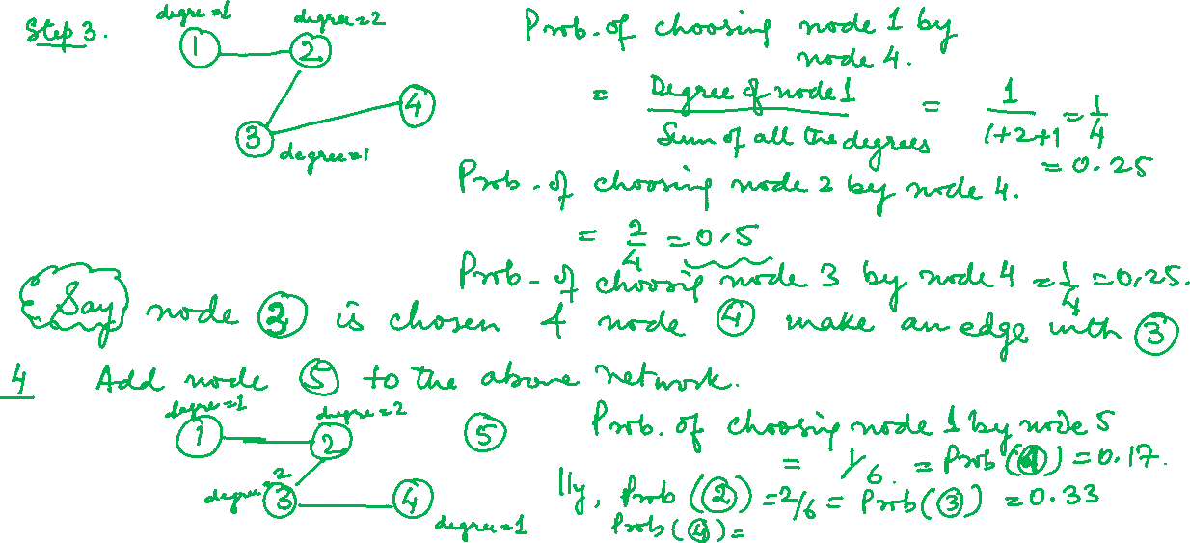
Graph Theory and its Applications
Preferential Attachment Model

Slide 9
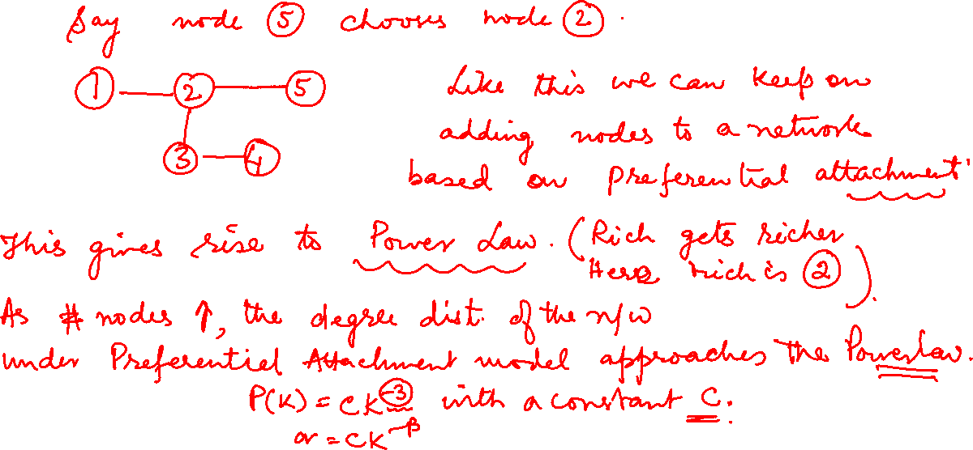
Graph Theory and its Applications
Preferential Attachment Model

Slide 10
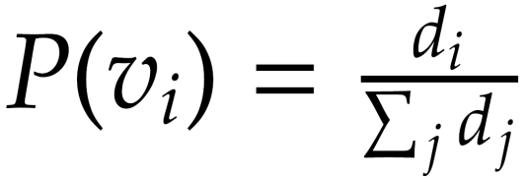

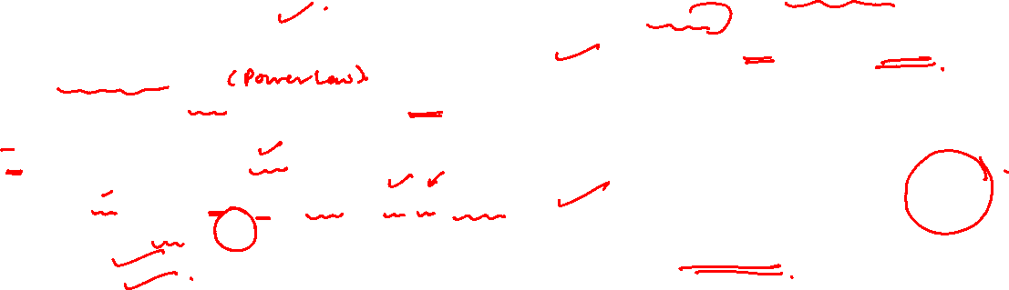
Graph Theory and its Applications
Constructing the model
Graph G(V₀, E₀) is given
For any new node v to the graph
Connect v to a random node v_{i} ∈ V₀, with probability
Growth : each new node gets connected to m other $m≤ m0$
Preferential attachment : Probability of connecting to node $v$_{i}
Note, initial $m0$ nodes must have at least degree 1
Degree distribution
This gives the power law (scale free nature)

Slide 11
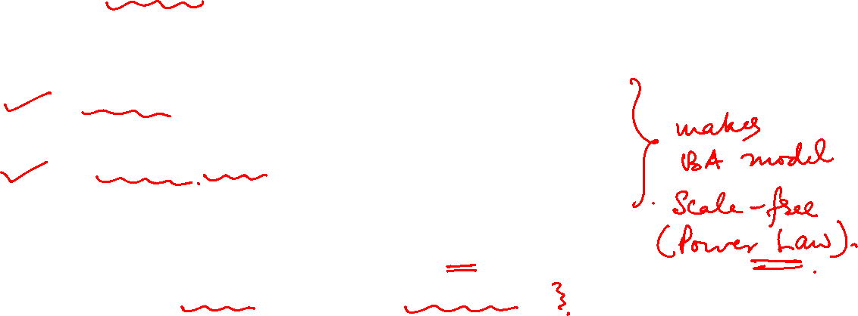
Graph Theory and its Applications
About the BA model
The model incorporates two ingredients
Growth element : realized by adding nodes as time passes by.
Preferential Attachment element – to achieve a scale-free network, edges are added in a specific way.
Removing any one of these ingredients generates networks that are not scale-free
Deals with undirected graph

Slide 12
Graph Theory and its Applications
Mathematical Proofs are skipped
Degree distribution that resembles a power law
Expression for average path length(increases logarithmically with the no of nodes in network)
Expression for clustering coefficient ( as the edges get formed independently, not many triangles get formed)

Slide 13

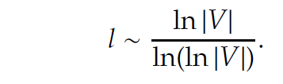
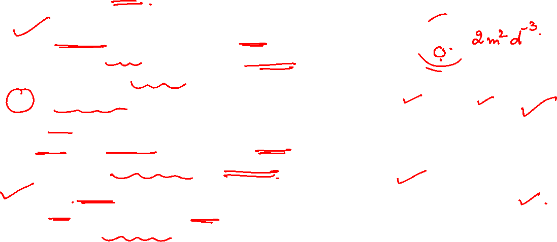
Graph Theory and its Applications
Properties of the BA model
Degree Distribution : Power law with Exponent 3 (real world graphs have this between 2 and 3)
Clustering coefficient is a function of time and it becomes smaller with time ( not possible to exhibit high clustering coefficient in BA model)
Average Path length is reasonably short and increases logarithmically with number of nodes. This is similar to Random Graph Model

Slide 14
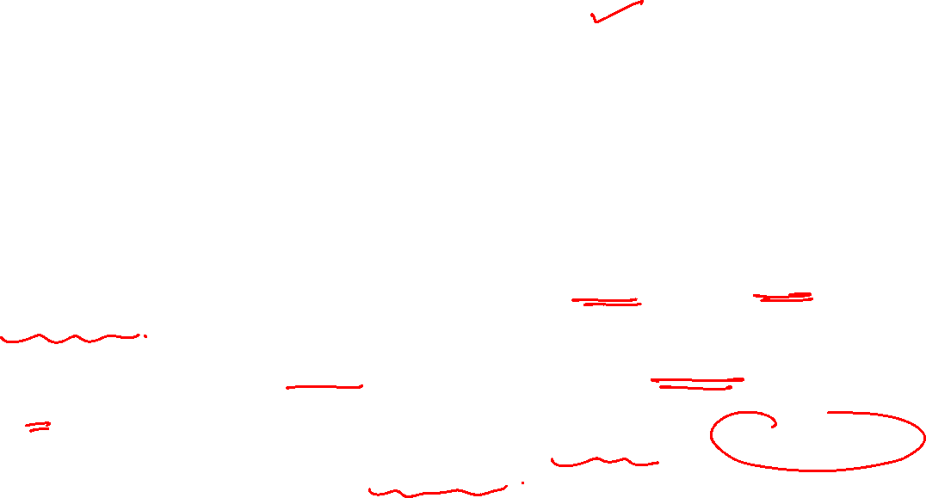
Graph Theory and its Applications
Real world networks and simulated graphs
The preferential attachment model generates a realistic degree distribution
The preferential attachment model generates small average path lengths;
However the generated networks fail to exhibit the high clustering coefficient observed in real-world networks

Slide 15
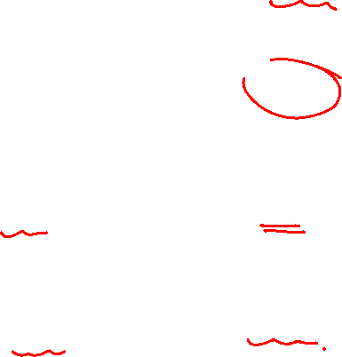
Power Law
Clustering Coeff
Average path Length
Random Graph Model | Watts Strogatz Small World Model | Barabasi Model
 |  | Follows
Low or underestimates( not diserable) | High | Low( not desirable)
Short ( desirable) | Short( desirable) | Short ( desirable)

Slide 16
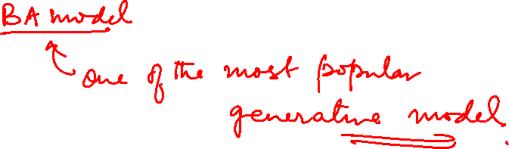
THANK YOU
Dr. Arti Arya
Department of Computer Science and Engineering

